Slide 1


Car sales analysis and prediction
Bootcamp project

Slide 2
Table of content
Context & topic selection
Data cleaning & Machine Learning engineering
Streamlit app
Learnings & challenges

Slide 3
Context & topic selection
Solving a business problem
Creating an app that can be easily used by a client
Linked to a database and can be updated
Showcasing knowledges learnt : Datviz to SQL to Machine learning

Slide 4
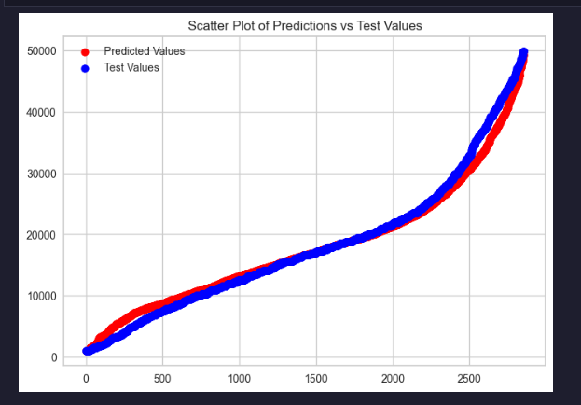
Data cleaning & Machine Learning engineering
180 000km to 180000
Audi A3 A3 to Audi A3
Categorical to Numerical
Target encoding
Feature encoding
Binning
Score 0,78
MAE 3100

Slide 5

Streamlit app

Slide 6
Learnings & challenges
Features realtionship
Machine learning engineering
Structuring the reflexion / code
Changing the dataset mid way
Challenging myself

Slide 7

Special MERCI to all of you for being great teachers and awsome classmates
Questions? Really?

